Slide 1


Text Mining and Natural Language Processing
Luis Miralles

Slide 2
Learning Goals
Understand the concept of text mining
Execute the main text-mining tasks
Learn the different approaches you can apply to text for extracting information.
Learn some popular Natural Language Techniques
Concept of Word Embedding and Bag of Words.
Build a data mining pipeline.

Slide 3
What is text mining?
Text mining, also known as text data mining or knowledge discovery from textual databases, refers to extracting exciting and non-trivial patterns or knowledge from text documents. It's the same as data mining but from text.
Tan, Ah-Hwee. "Text mining: The state of the art and the challenges." Proceedings of the pakdd 1999 workshop on knowledge discovery from advanced databases. Vol. 8. 1999.

Slide 4
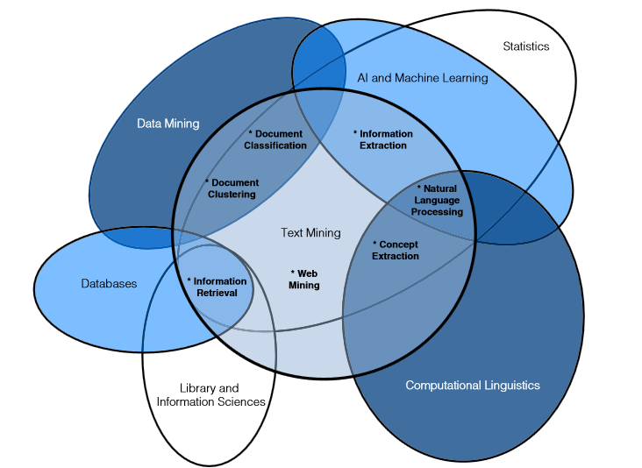
Text mining is a multidisciplinary field

Slide 5
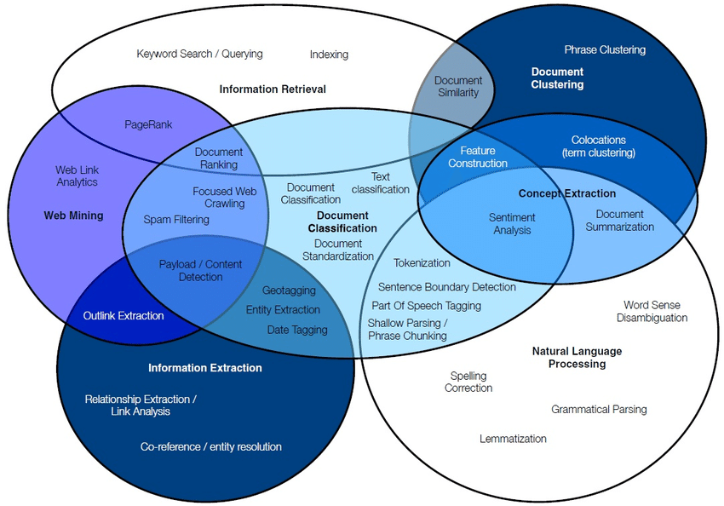
Text Mining applications
Ramzan Talib, Muhammad Kashif Hanif, Shaeela Ayesha and Fakeeha Fatima, “Text Mining: Techniques, Applications and Issues” International Journal of Advanced Computer Science and Applications(ijacsa), 7(11), 2016. http://dx.doi.org/10.14569/IJACSA.2016.071153

Slide 6

Introduction
The amount of text generated on the web has dramatically increased in the last few years.
Think about the number of websites, blogs, tweets, and other material you can find on the internet.
The amount of data has been doubling every two years.

Slide 7
The main challenges with Text Mining
The information is unstructured, between 80% and 90%.
There are different languages.
Words have multiple meanings: Bank, date, bat, right, jam, light, etc.
Phrasal verbs: take (up, off, down….),
Language can be misleading (Irony, sarcasm, etc.)

Slide 8
Main problems with Text Mining
Flexibility: There are multiple ways of saying the same thing.
Texts have multiple lines. And does not have a fixed longitude.
Multiword expressions (idioms): bit around the bush, go bananas, in a nutshell, etc.
Expressivity: Multiple ways of saying the same thing: “He gave the phone to Jack.” or “He gave Jack the phone.”

Slide 9
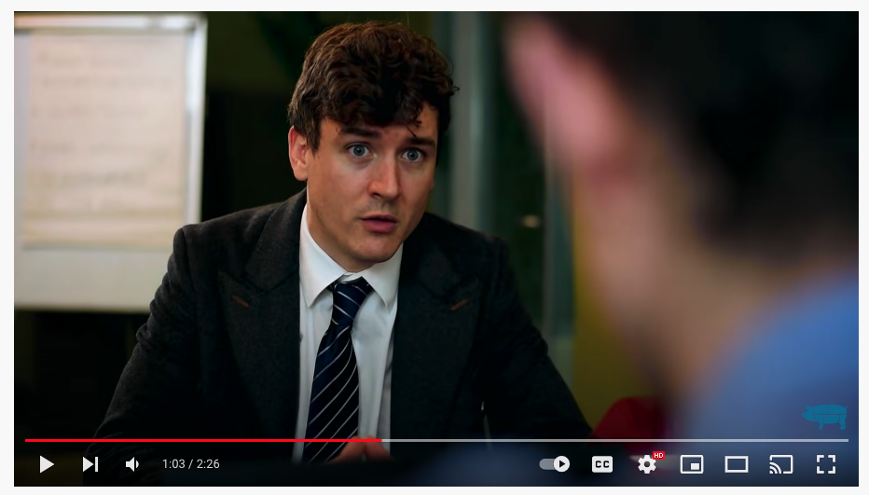
How can language be understood?
Never Take an Irish Person Literally - Foil Arms and Hog
https://youtu.be/-9CV-aQ45VE

Slide 10
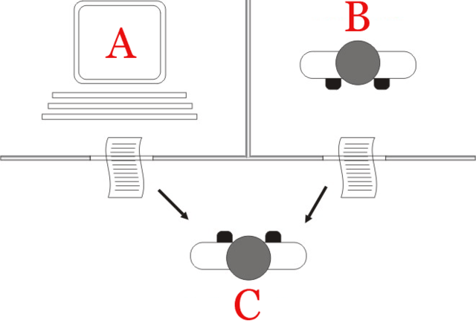
Turing test and text mining
The Turing test was designed by the famous scientist Alan Turing
It consists of a human trying to guess if what is answering questions on the other side is a machine or a human.

Slide 11
Typical approaches with text mining
Text preprocessing: In this step, we make the information more suitable for the TM algorithms. E. g., removing unimportant words (stopping words) or counting the number of words.
Categorization: It labels the documents with one or more categories based on experience.
Clustering: It means creating groups of documents that have similar texts.
Visualization: It helps to display information in a way humans can understand it quickly.
Patter identification: Extracting useful information from the data (email, phones…). It can be done with regular expressions.
Write Summaries: It is possible to use text mining to select highlights of the different information to create short documents with the essential information.

Slide 12
Some applications of text mining
Speech recognition: TM can be applied to improve performance by selecting words that are more likely to appear next to others (as the human mind works).
Spam filtering: The content of messages can be automatically analysed to apply spam filtering. Gmail and other companies use this.
Sentiment Analysis: Categorizes if a sentence is positive, negative, or neutral. It is difficult because sometimes there is irony, sarcasm, slang, or language with many typos.
Online advertising: It matches the keywords advertisers select with the web text displayed in the advert.
Accessibility: Automatically translate images to blind people.

Slide 13
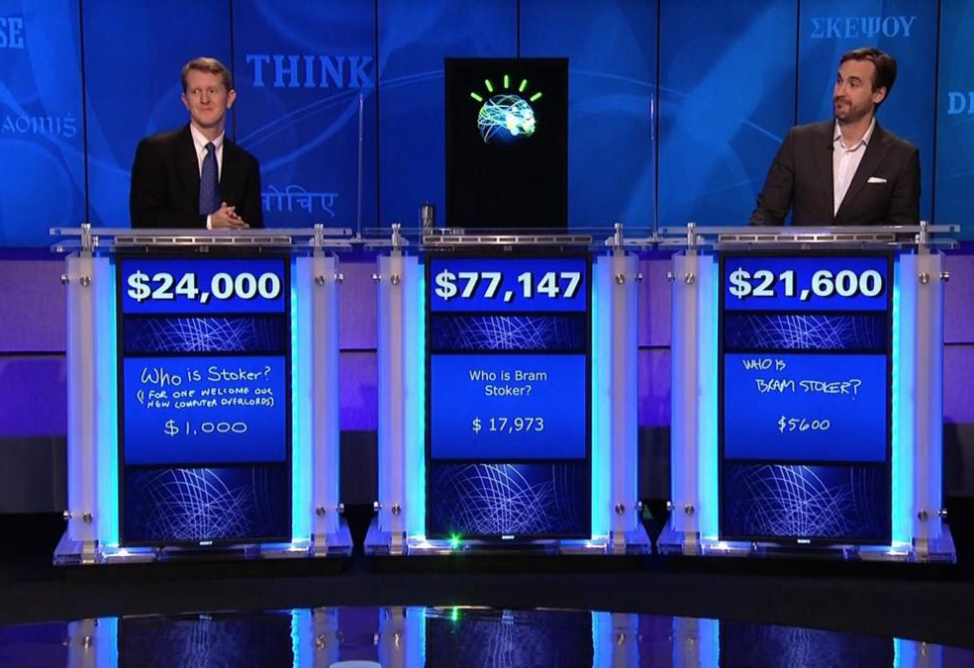
Watson by IBM
In 2011, IBM designed a system that could compete in solving questions with the best humans in the game of “Jeopardy!”

Slide 14
Typical techniques
Text document is represented by the number of words it contains and its frequency
Stemming: Means that words are stemmed and the suffix is removed. For example, trained, training, and train will be the same word.
Stop words: The stop words such as “and, with, or, of, etc.” are generally removed.
It is important to reduce the dimensionality of the space
Features generation: Bag of words
Features selection: Simple counting and statistics.
Topic modeling: Multiclassification
Tokenization: Convert words into sequences of characters

Slide 15
NLP vs Text Mining
NLP is used to understand human language by analysing text, speech, or grammatical syntax. Grammarly, the app, is an example of NLP.
Text mining is used to extract information from unstructured and structured content.
When you are trying to understand the data, it is called NLP; when you are trying to discover patterns, it is text mining.

Slide 16
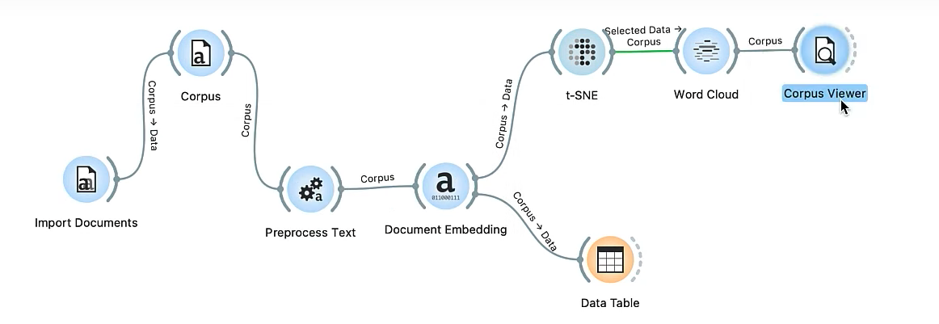
Representing documents using T-SNE
https://youtu.be/I2bk09bzGE8?feature=shared

Slide 17
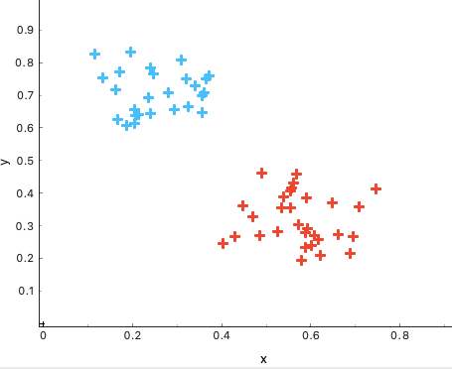
Exercises with Clustering
Dendogram
Clustering consists of grouping similar objects and separating the ones that are different.
Two main cluster algorithms:
K-means exercise with educational “Add-on” in orange
Dendrogram in orange
K-means
https://www.youtube.com/watch?v=WmzdMKVG07w&ab_channel=ManuelCurral

Slide 18
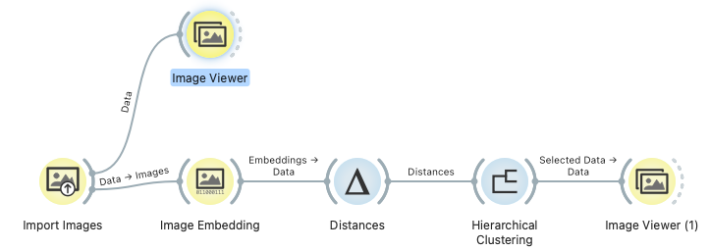
Clustering with images
The magic for doing this
is captured in this module
https://youtu.be/Iu8g2Twjn9U
https://github.com/ajdapretnar/datasets/blob/master/images/domestic-animals.zip

Slide 19

Section 3: Preprocessing steps in Text Mining

Slide 20
Stemming
The idea here is to keep the prefix of a word and remove its postfix.
Consider the words: "run," "running”, and "runner”. In stemming, these words would be reduced to their common root, "run”.
The algorithm for performing stemming is called a stemmer and has different variations, such as a snow stemmer or a Lancaster stemmer.

Slide 21
Lemmatization
The idea behind lemmatisation is converting all the variations of one word into the original word.
For example, if we had the words: “seeing”, “sees”, “saw”, “seen”, etc. All these words will be converted to the word “see”.
This is done by listing all the different variations a word can have.

Slide 22
POS Tagging
This technique can mark the different words of a sentence with the semantical word they are doing.
For example, the sentence: “The red cat jumped a fence” will be “{The, article}, {red, adjective}, {cat, noun}, {jumped, verb}, {a, article}, {fence, noun} ”.
This helps find relationships between the words and is used in translating documents.

Slide 23
NLP Process Workflow
Tokenisation: Separate the text into words. Remove punctuation.
Remove Stopwords: Filter words that are not very meaningful from the text.
Stemming and lemmatisation: Remove all the variations of a word and simplify the text by eliminating different synonyms.
POS Tagging: Find the function a word is doing in a sentence (Verb, noun, adjective, etc.)

Slide 24

What are N-Grams?
N-grams are groups of n-words that occur in a sentence.
For example, the sentence: “The cat is lying on the window” has the following N-Grams:
Unigrams: “The”, “cat”, “is”, “lying”, “on”, “the” ,…
Bigrams: “The cat”, “cat is”, “is lying”, “lying on”,…
Trigrams: ”The cat is”, “cat is lying”, “is lying on” ,…

Slide 25
Stop words
Stop words are natural words that do not give too much meaning to the text and are mainly for connecting essential words.
Typical examples of stop words are: the, or, is, with, though, of, my, and so on.
Usually, there is a list of stop words which are removed from the text as part of the preprocessing step.

Slide 26
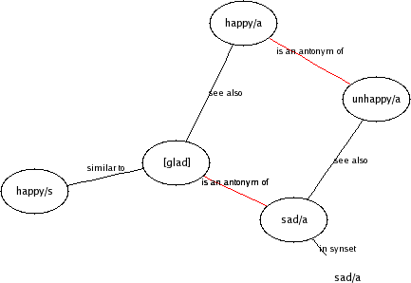
WordNet
WordNet is the most well - developed and widely used lexical database for English.

Slide 27
Google N-Gram corpus
Google published a n n-gram corpus with statistics on different word occurrence s.
Number of uni-grams: 13,588,391
Number of bi-grams: 314,843,401
Number of tri-grams: 977,069,902
Number of four-grams: 1,313,818,354
Number of five-grams: 1,176,470,663
http://googleresearch.blogspot.com/2006/08/all-our-n-gram-are-belong-to-you.html#links

Slide 28
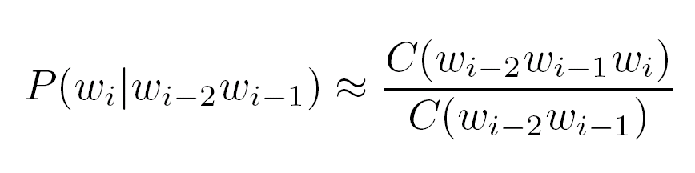
Predicting the next word
Predicting the next word can be useful for handwriting recognition, machine learning, spelling correction, etc.
We can calculate the probability of a word by applying the trigram.
Frequency of word sequences

Slide 29
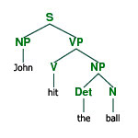
Parse trees
Parsing a sentence is an essential step in understanding its meaning
The input is a sentence, and the output is a parse tree

Slide 30
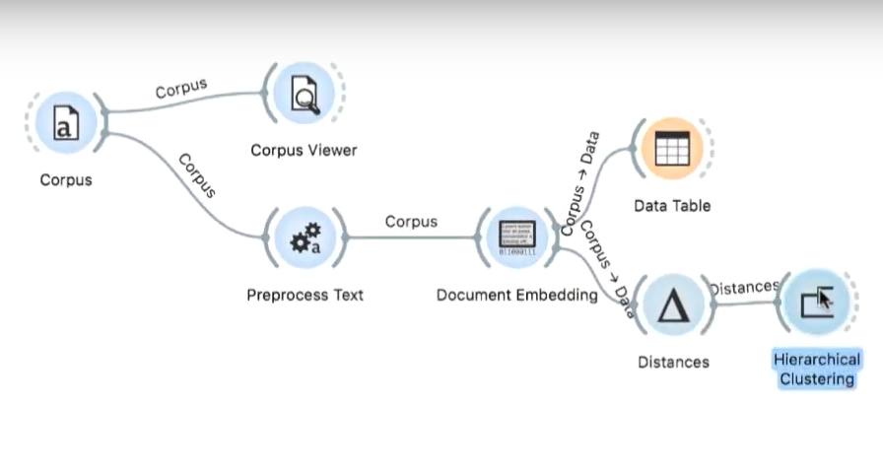
Hierarchical Clustering using Document Embeddings
https://youtu.be/FPp3pDCw7u4?feature=shared

Slide 31
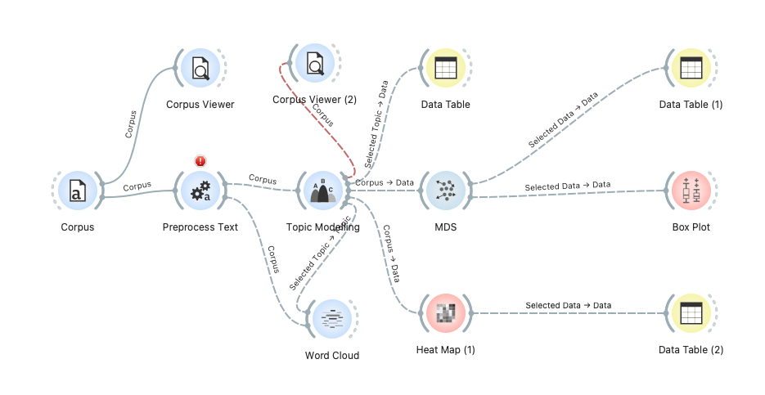
Topic modelling using text mining
https://www.youtube.com/watch?v=r9AINv51O0g

Slide 32

PRINCIPAL TEXT MINING TECHNIQUES

Slide 33
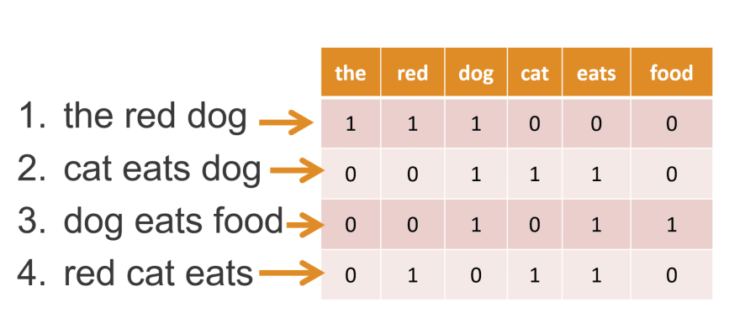
What is bag of words?
https://medium.com/swlh/spam-filtering-using-bag-of-words-aac778e1ee0b

Slide 34
Bag of words
It is possible to represent a new document as a vector in which columns are the different words all documents have, and rows are the weight of those words.
The weight is obtained considering the frequency of the word in the text compared to all documents.
Features
Skin green. Shadow. cell molecule nucleus biotic
A 1.0 0.5 0.3
B 0.5 1.0
C 0.4 1.0 0.8 0.7
D 0.9 1.0 0.5
E 0.5 0.7 0.9
F 0.6 1.0 0.3 0.2 0.8
Document vector
Document Ids

Slide 35
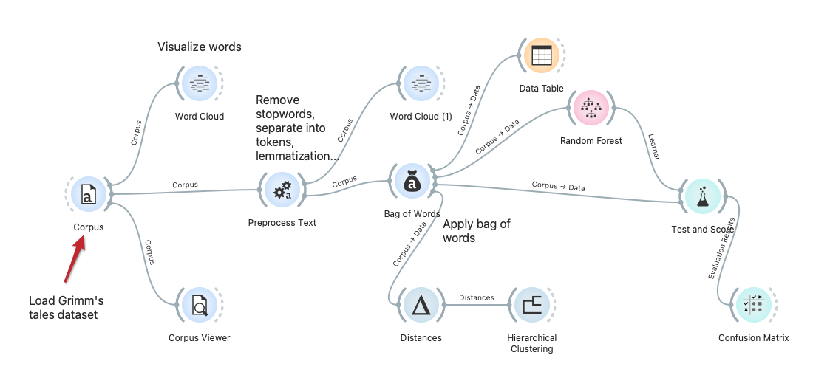
Text Mining pipeline using Bag of Words

Slide 36
TF-IDF: Term frequency-inverse document frequency
The most popular weighting schema for word weighting is based on normalisng word frequency
Tf(w) – term frequency (number of word occurrences in a document)
Df(w) – document frequency (number of documents containing the word)
N – number of all documents
Tf-Idf(w) – the relative importance of the word in the document
The word is more important if it appears
several times in a target document
The word is more important if it appears in less documents

Slide 37
Similarity measure: Comparing two documents
Each document can be represented as a vector of weights D = <x>
Cosine similarity is a similarity measure used to compare two documents, where cosine calculates the angle as the sum of the products of the different words. If 0, they are entirely different; if 1, they are the same.
Doc 1
Doc 2
Similarity

Slide 38
Word Embedding and Word2Vec
Word Embedding is simply representing a word by a vector. All vectors have the same side; therefore, it is easier for an ML algorithm to classify them. Some algorithms are used to predict the next word.
We can add, subtract, and use vectors. We can also calculate the distance between the words to see which ones are more related. For example, King – Man + Woman = Queen.
Recommended video: https://www.youtube.com/watch?v=oUpuABKoElw
https://gist.github.com/aparrish/2f562e3737544cf29aaf1af30362f469

Slide 39
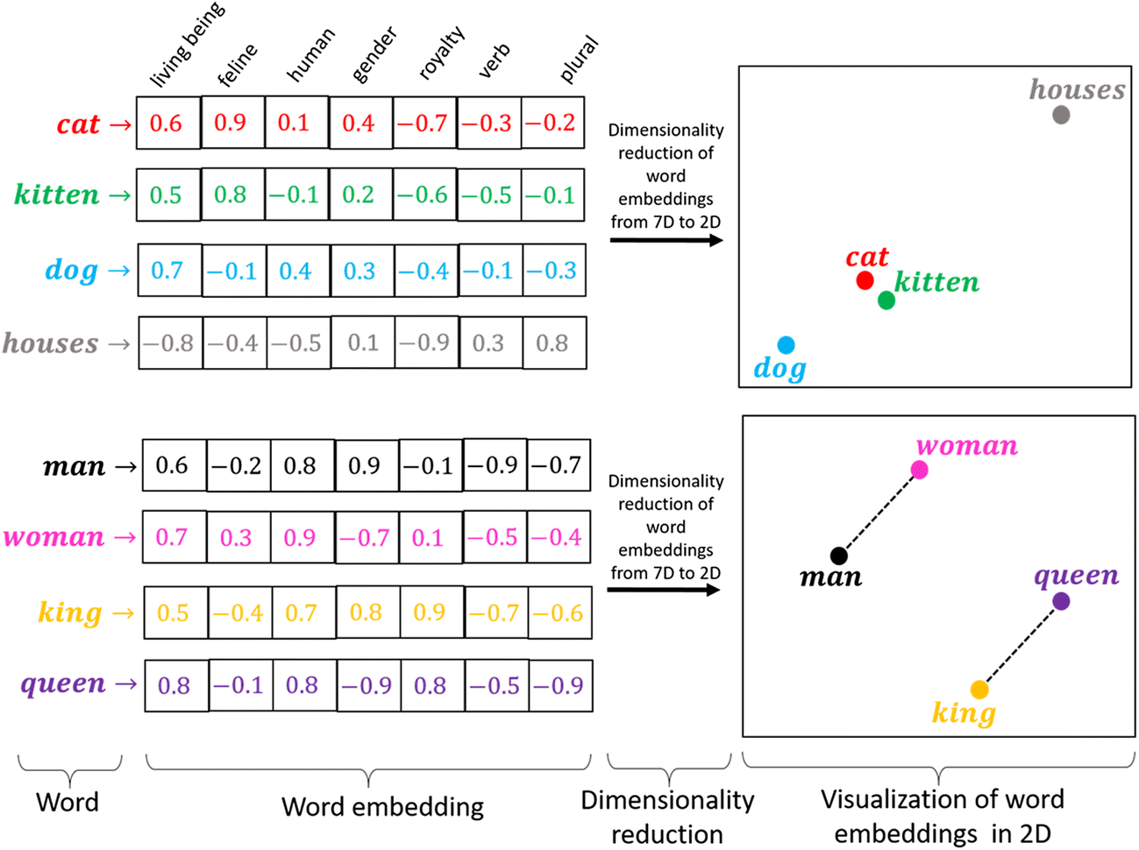
Word2vec
Word2vec try to solve the problem of a bag of words
Vectors are very sparse. They can have extended sizes with very few values.
They cannot predict new words.
Embeddings try to represent words with a dense vector, making words with similar meanings have similar values—for example, tea and coffee.
Words can be compared using the cosine similarity.
https://medium.com/@hari4om/word-embedding-d816f643140

Slide 40
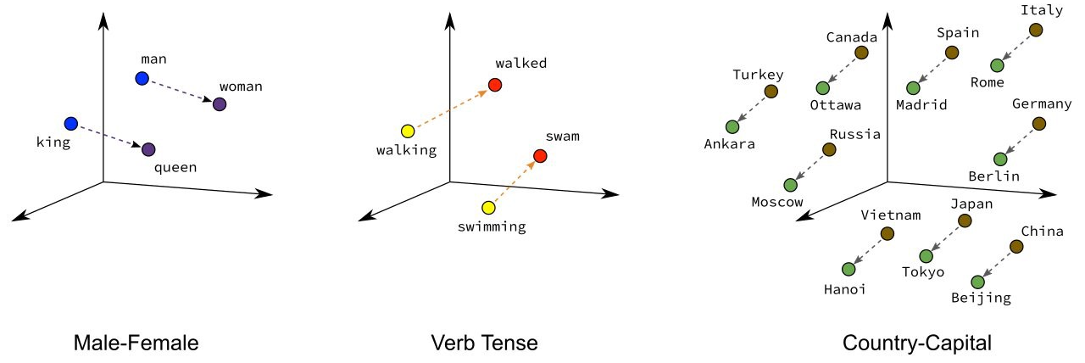
Word2Vec
By using vectors, we can add and subtract words as:
King – Man + Woman = Queen

Slide 41
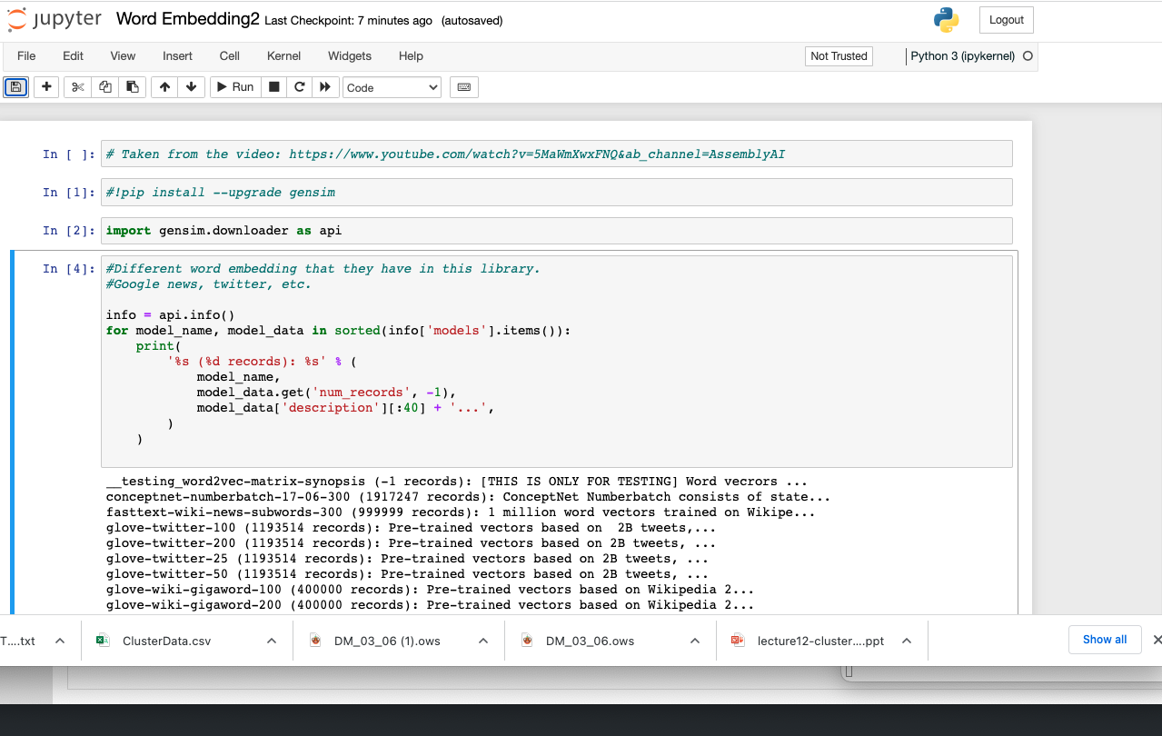
Examples in Python

Slide 42
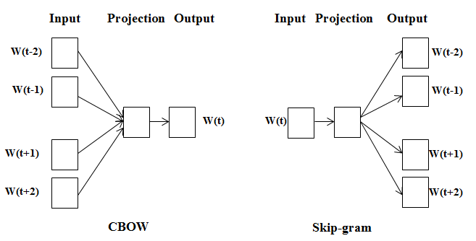
Approaches in Word2vec
If we have the sentence: "The quick brown fox jumps over the lazy dog” which contains all the alphabet letters.
The Continuous-Bag-Of-Words will try to use “N-grams”, groups of N words, to predict one of the centres. For example, we say: “The quick fox jumps”, and it will try to predict the word.
The skipgram model learns to predict a target word thanks to a nearby word.
The cbow model predicts the target word according to its context.

Slide 43
Word Embedding and Word2Vec
Algorithms for generating the words:
CBOW: Continuous Bags of words. In this approach, the neural network will try to predict the word jump. “The quick brown fox jumps over the lazy dog”.
Skip gram: We do the opposite thing. We predict the words from the word jump.

Slide 44
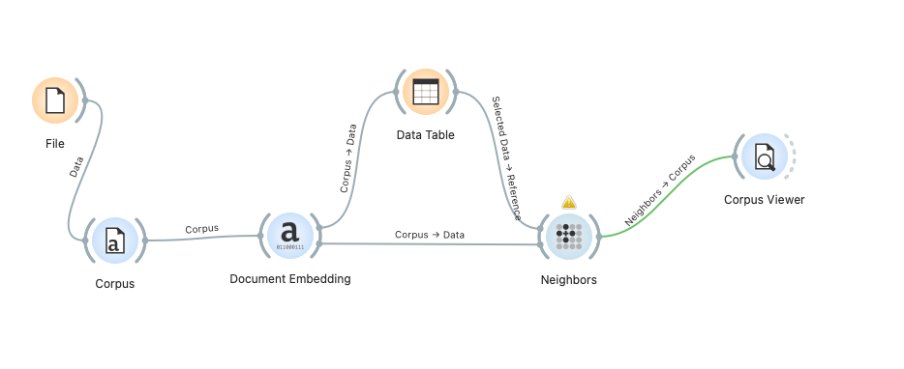
Word2vec Orange example
https://www.youtube.com/watch?v=RIFwBbbbvbI

Slide 45

Transfer Learning: Reusing pre-trained models
Training a model requires a lot of computation power and is costly.
The easiest solution is to use a pre-trained model. There are multiple models in the literature that you can use.
The main advantage of reusing a model is that it saves time and effort.
You can also apply a technique called “transfer learning”, by which you will retrain a model already trained in your area.

Slide 46
ML Approaches
Supervised learning:
We have different classes of documents.
The future predictions will be a class of the training set.
Clustering:
No label in the dataset
We will maximise the distance inter-cluster and minimise the intra-clusters
Future cases will be associated with one cluster.

Slide 47

Popular Libraries (Python)
Natural Language Toolkit Library (NLTK) is one of the most popular libraries for text mining.
It is used to work with human language and applying typical TM techniques.

Slide 48
NLP versus Text Mining
Aspect | Text Mining | NLP
Definition | Extracting insights from text data. | Computer-human interaction using natural language.
Scope | Focus on patterns in unstructured text. | Broader, includes various language-related tasks.
Goal | Reveal patterns in large text datasets. | Understand, generate human-like language.
Techniques | Text preprocessing, statistical analysis. | Syntactic, semantic analysis, sentiment analysis.
Data | Unstructured text from documents, social media. | Both structured and unstructured data.
Applications | Sentiment analysis, document categorization. | Machine translation, chatbots, speech recognition.
Focus on Language Structure | Extract meaningful information; less on structure. | Deep analysis of grammar, semantics, language context.
Example Tasks | Text clustering, summarization. | Named entity recognition, part-of-speech tagging.

Slide 49
References
Complete course in Text Mining: https://www.cc.gatech.edu/classes/AY2020/cs7650_spring/
Hussam Haranni - https://www.youtube.com/watch?v=r9AINv51O0g
Explanation Word2Vec: https://www.youtube.com/watch?v=d2E-pU4H2gc
https://www.youtube.com/watch?v=5MaWmXwxFNQ&ab_channel=AssemblyAI
Stop words: https://github.com/HussamHourani/HussamHourani/blob/Orange-Datamining/English/stopwords.txt
Playlist Orange DM videos: https://www.youtube.com/playlist?list=PLYW0LRZ3ePo5jW_mhbvHV5ciNkhe61dTT

